Slide 1
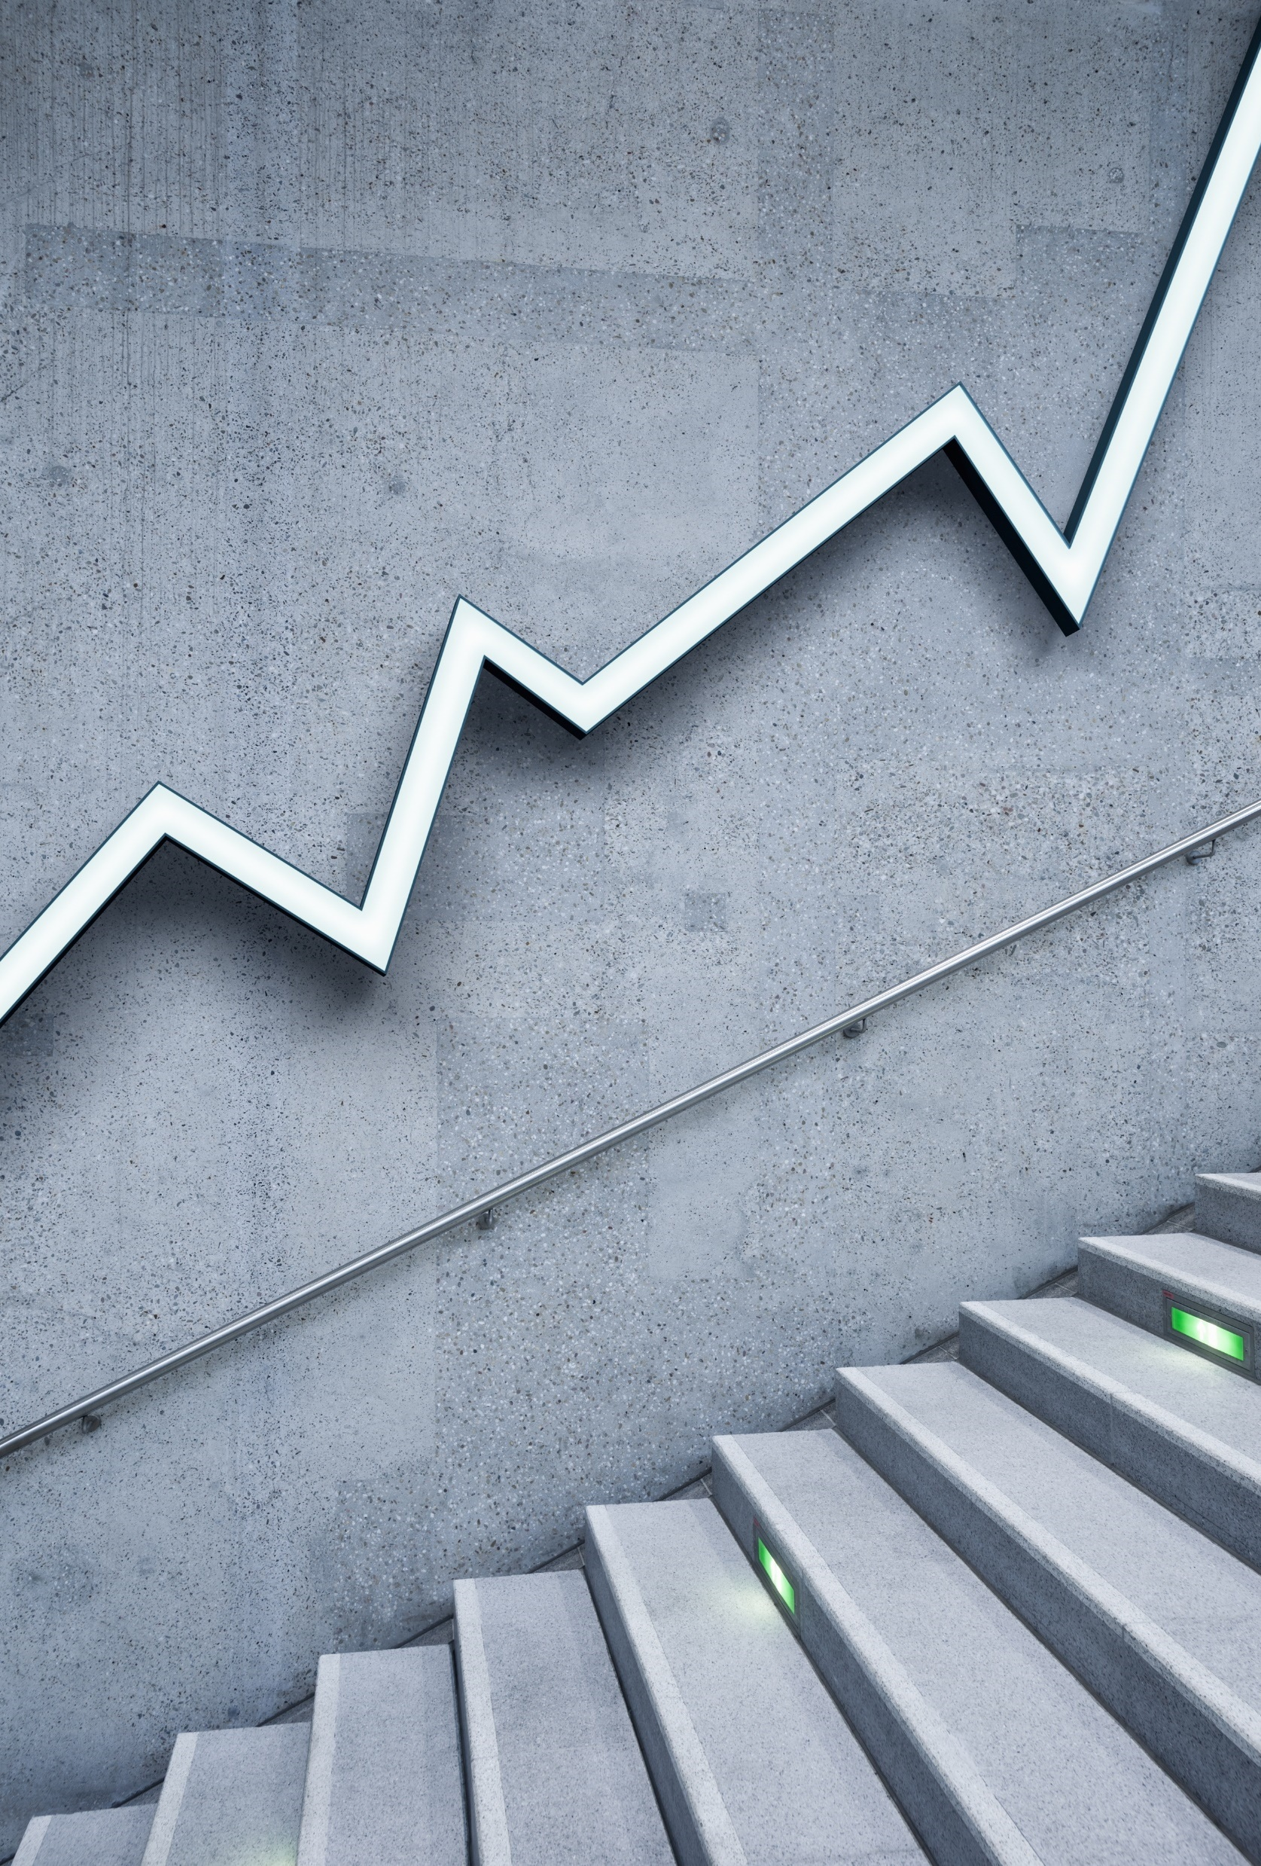
Statistical concepts

Slide 2
CONTENTS
Measures of central tendency and dispersion
Sampling
Coefficient of variation
Multicollinearity
Hetro and homo scedasticity
Gausian distribution
Market basket analysis
SQL

Slide 3
MEASURES OF CENTRAL TENDENCY
Central Tendency
Mean
Median
Mode
Arithmetic
Geometric
Harmonic

Slide 4
Three Order of Measurement of Average
First Order
Second Order
Third Order
Measures of Central Tendency
Measures of Dispersion
Measures of Skewness and Kurtosis

Slide 5
MEASURES OF DISPERSION
Range : (max – min)
Quartile:
Mean Deviation:
  To compute how far the values in a data set are from the center point.
Standard Deviation:
  It is the average amount of variability in your dataset. It tells you, on average, how far each value lies from the mean.
Coefficient of Variance:
  It is a measurement of the relative variability (consistency) of data.
1st Quartile
2nd Quartile
3rd Quartile

Slide 6
EXAMPLES OF CORRELATION
Positive Correlation
1) Height Vs Weight
2) Temperature Vs Ice-cream Sales
Negative Correlation
1) Time Spent Running Vs Body Fat
2) Time Spent On Watching TV Vs Exam Score
Zero Correlation
1) Coffee Consumption Vs Intelligence
2) Shoe Size Vs Movie Watched

Slide 7
DIFFERENCE BETWEEN CLUSTER SAMPLING AND STRATIFIED SAMPLING
Sample
Objective / Purpose
Error
Homogeneity
Heterogeneity

Slide 8
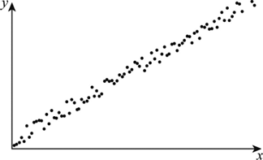
HOMO SCEDASTICITY
important assumption of OLS
Error term have the same variance.
Homo means equal and scedasticity means spread.

Slide 9
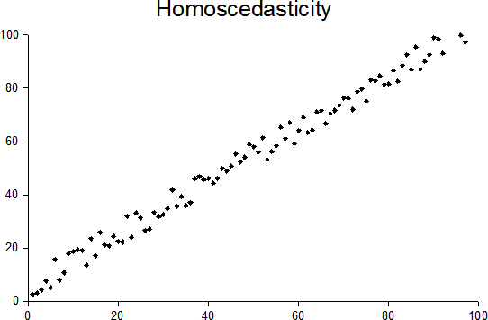
HETRO SCEDASTICITY
Variance of the residual is unequal
Heteroskedasticity is a violation of the assumptions for linear regression modeling.
Occure when large difference among the sizes of the observations.

Slide 10
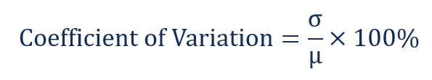
COEFFICIENT OF VARIATION
The coefficient of variation (relative standard deviation) - statistical measure
The lower the ratio of the standard deviation to mean return, the better risk-return trade-off.
Formula of coefficient of variation :

Slide 11
MULTICOLLINEARITY
Multicollinearity – High correlation among independent variables
Multicollinearity will result in less reliable statistical inferences.
Detection of multicollinearity
Scatter plot and correlation marices
Incorrect coefficient
Instability of the coefficient
Review the variance inflation factor
How to deal with multicollinearity

Slide 12
MARKET BASKET ANALYSIS
WHAT IS IT?
Market basket analysis is a data mining technique used by retailers to increase sales by better understanding customer purchasing patterns.
It identifies the strength of association between pairs of products purchased together and identify patterns of co-occurrence.
This process identifies customer buying habits by finding associations between the different items that customers place in their “shopping baskets”

Slide 13
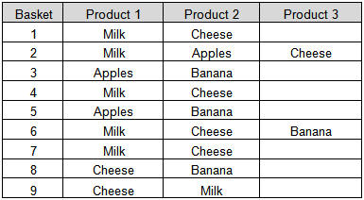
EXAMPLE OF ASSOCIATION RULE
MEASURES FOR ASSOCIATION
Support
Confidence
Lift
BASKET 1:- (Milk & Cheese)
Support = 0.667
Confidence = 1
Lift = 1.2857

Slide 14
ADVANTAGES
Increases customer engagement
Boosting sales
Improving customer experience
Optimize marketing strategies and campaigns
Identifies customer behavior and pattern

Slide 15
APPLICATIONS
TELECOMMUNICATIONS
  What packages customers are purchasing?
RETAIL
  Does it make sense to sell coldrink with chips?
BANKS
  analyze credit card purchases of customers to build profiles for fraud detection purposes.
INSURANCE
  build profiles to detect medical insurance claim fraud

Slide 16
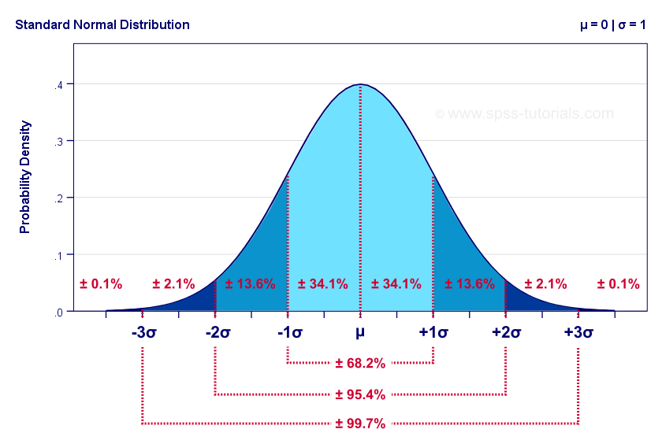
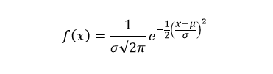
NORMAL DISTRIBUTION
Normal distribution, also known as the Gaussian distribution, is a continuous probability distribution.
It is the most common and widely used probability distribution.
It is symmetrical about mean.
PDF :-
where x : value of variable
μ : mean
σ : standard deviation

Slide 17
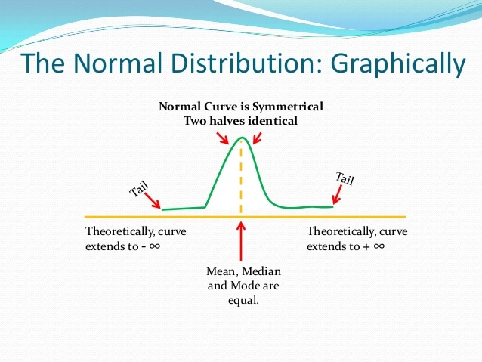
PROPERTIES
IT IS “BELL – SHAPED”.
MEAN, MEDIAN AND MODE ARE EQUAL.
TOTAL AREA UNDER THE CURVE IS 1.
SYMMETRICAL ABOUT MEAN.
ASYMPTOTIC
SKEWNESS :- 0
KURTOSIS :- 3
LOCATION :- μ
SPREAD :- σ

Slide 18
EXAMPLES
Height
Rolling a Dice
Flipping a Coin
IQ of a person
Income Distribution
Shoe size
Weight
Student’s marks

Slide 19
THE STRUCTURED QUERY LANGUAGE (SQL)
Database
Relational database
RDBMS
SQL is a computer language for storing, manipulating and retrieving data stored in a relational database.
Standard language
Divided into several different types
-DDL
-DML
-DCL
-TCL

Slide 20
DDL
CREATE DATABASE statement
CREATE TABLE statement
ALTER TABLE Statement
DROP TABLE Statement
CREATE VIEW Statement
DROP VIEW Statement
DML
SELECT statement
INSERT statement
DELETE statement
UPDATE statement
DCL
GRANT
REVOKE

Slide 21
SQL Standard data types
String types
Numeric Types
Datetime types
SQL Constraints
NOT NULL
UNIQUE
PRIMARY Key
FOREIGN Key
CHECK

Slide 22
THANK YOU

